Slide 1



Fast Network K-function-based Spatial Analysis
(Edison) Tsz Nam Chan¹ Leong Hou U² Yun Peng³
Byron Choi¹ Jianliang Xu¹
¹Hong Kong Baptist University ²University of Macau ³Guangzhou University

Slide 2


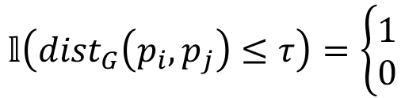

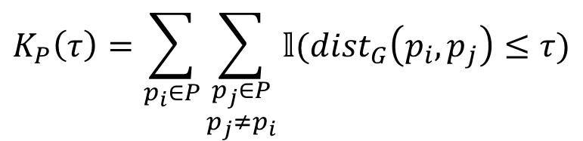



What is Network K-function?
A fundamental GIS operation for checking whether the clusters/hotspots (discovered by the clustering/hotspot detection algorithms) in the datasets are significant.
Network K-function is defined as:
Shortest path distance
$$K_{P}\left(τ\right)=\sum_{p_{i}∈P}{\sum_{\begin{aligned}p_{j}∈P \\ p_{j}≠p_{i}\end{aligned}}{𝕝({dist}_{G}\left(p_{i},p_{j}\right)≤τ)}}$$
where
$$𝕝\left({dist}_{G}\left(p_{i},p_{j}\right)≤τ\right)=\left\{\begin{matrix}1 \\ 0\end{matrix}\right.$$
if ${dist}_{G}\left(p_{i},p_{j}\right)≤τ$
otherwise
Dataset
Road network
Threshold
Road 1
Road 1
$$τ$$
$$τ$$
$$τ$$
$$τ$$
Road 2
Road 2
(a) Clustered
(b) Dispersed

Slide 3
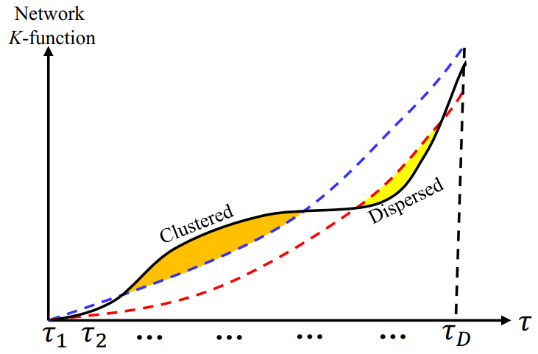
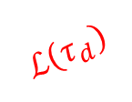

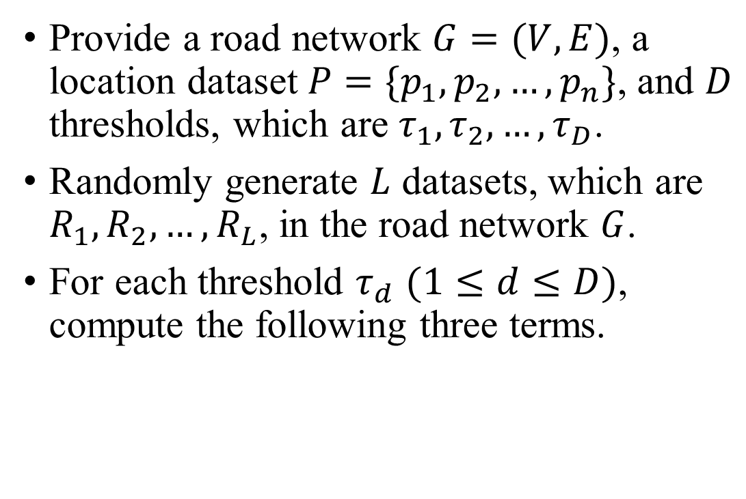
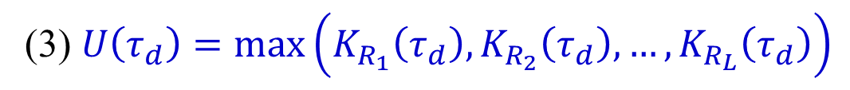
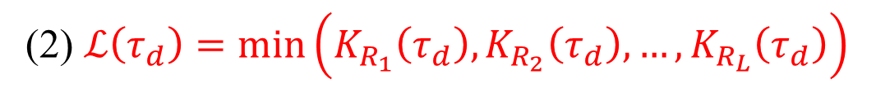


How do Domain Experts Use this Operation?
Provide a road network $G=(V, E)$, a location dataset $P=\{p_{1},p_{2},…,p_{n}\}$, and $D$ thresholds, which are $τ_{1},τ_{2},…,τ_{D}$.
Randomly generate $L$ datasets, which are $R_{1}, R_{2}, …, R_{L}$, in the road network $G$.
For each threshold $τ_{d}$ $(1≤d≤D)$, compute the following three terms.
$$K_{P}\left(τ_{d}\right)$$
$$U\left(τ_{d}\right)$$
$$ℒ\left(τ_{d}\right)$$
(1) $K_{P}\left(τ_{d}\right)$
(2) $ℒ\left(τ_{d}\right)=min⁡\left(K_{R_{1}}\left(τ_{d}\right),K_{R_{2}}\left(τ_{d}\right),…,K_{R_{L}}\left(τ_{d}\right)\right)$
(3) $U\left(τ_{d}\right)=max⁡\left(K_{R_{1}}\left(τ_{d}\right),K_{R_{2}}\left(τ_{d}\right),…,K_{R_{L}}\left(τ_{d}\right)\right)$

Slide 4
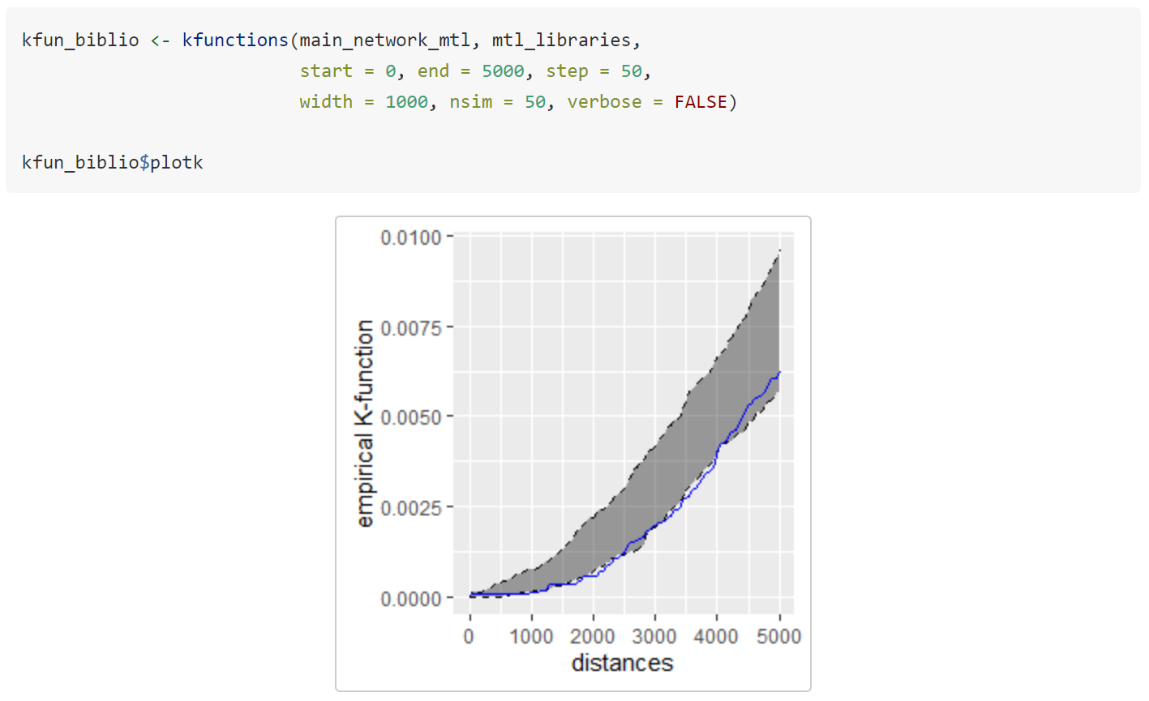
Many GIS Software Packages Can Support Network K-function!
spNetwork (an R package) [1]
QGIS/ArcGIS (based on the SANET plugin [2])
PySAL (a python library) [3]
Generate the network K-function plot by the R package.
[1] spNetwork: Spatial Analysis on Network - R Project. https://cran.rproject.org/web/packages/spNetwork/spNetwork.pdf.
[2] SANET. http://sanet.csis.u-tokyo.ac.jp/.
[3] PySAL. https://pysal.org/.

Slide 5
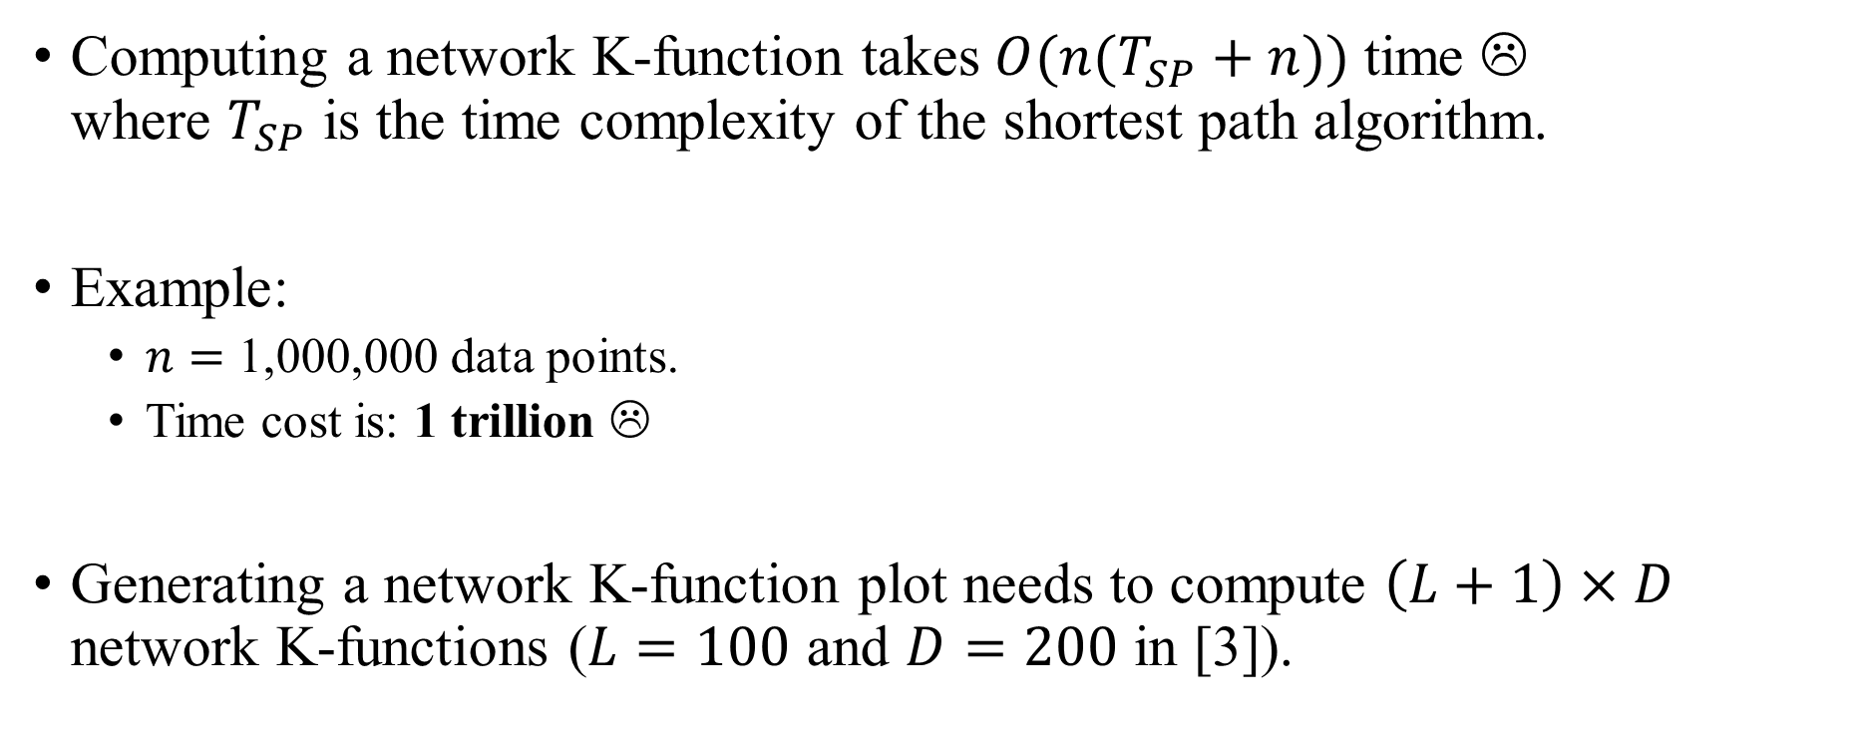
Network K-function is Slow!
Computing a network K-function takes $O(n(T_{SP}+n))$ time ☹ where $T_{SP}$ is the time complexity of the shortest path algorithm.
Example:
$n=$ 1,000,000 data points.
Time cost is: 1 trillion ☹
Generating a network K-function plot needs to compute $\left(L+1\right)×D$ network K-functions ($L=100$ and $D=200$ in [3]).
[3] David S. Lamb, Joni A. Downs, and Chanyoung Lee. 2016. The network K-function in context: examining the effects of network structure on the network K-function. Transactions in GIS 20, 3 (2016), 448–460.

Slide 6
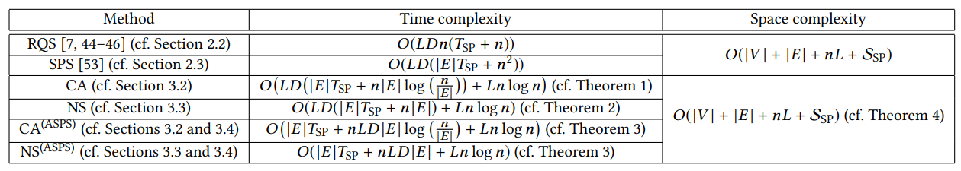
Our Contributions
Reduce the time complexity for generating a network K-function plot, without increasing the space complexity.
Achieve up to 165.85x speedup compared with the state-of-the-art methods.

Slide 7

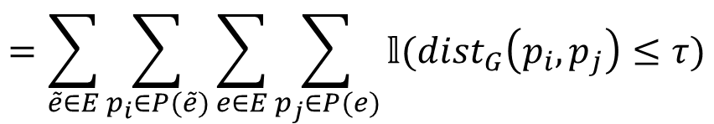
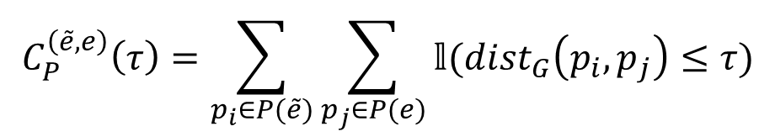








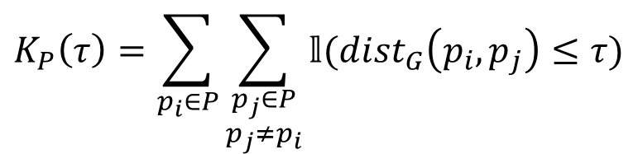

Decomposition of the Network K-function
Let $P(e)$ be the set of data points in an edge $e$ of a road network.
$$a$$
$$\tilde{e}=(a,b)$$
$$b$$
$$K_{P}\left(τ\right)=\sum_{p_{i}∈P}{\sum_{\begin{aligned}p_{j}∈P \\ p_{j}≠p_{i}\end{aligned}}{𝕝({dist}_{G}\left(p_{i},p_{j}\right)≤τ)}}$$
$$u$$
$$e=(u,v)$$
$$v$$
$$=\sum_{\tilde{e}∈E}{\sum_{p_{i}∈P(\tilde{e})}{\sum_{e∈E}{\sum_{p_{j}∈P(e)}{𝕝({dist}_{G}\left(p_{i},p_{j}\right)≤τ)}}}}$$
$$=\sum_{\tilde{e}∈E}{\sum_{e∈E}{C_{P}^{\left(\tilde{e},e\right)}(τ)}}$$
$$C_{P}^{\left(\tilde{e},e\right)}\left(τ\right)=\sum_{p_{i}∈P(\tilde{e})}{\sum_{p_{j}∈P(e)}{𝕝({dist}_{G}\left(p_{i},p_{j}\right)≤τ)}}$$
where
is the $\left(\tilde{e},e\right)$-count function.
Question: Can we reduce the time complexity for computing the $\left(\tilde{e},e\right)$-count function $C_{P}^{\left(\tilde{e},e\right)}\left(τ\right)$ (e.g., from $O(\left|P(\tilde{e})\right|\left|P(e)\right|)$ to $O(\left|P\left(\tilde{e}\right)\right|+\left|P(e)\right|)$)?

Slide 8
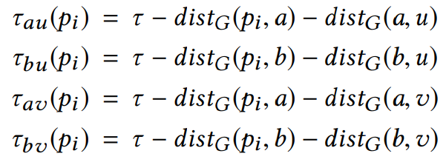
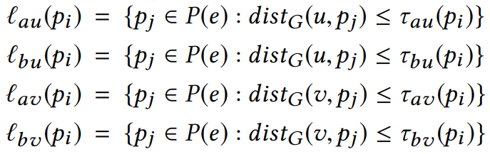




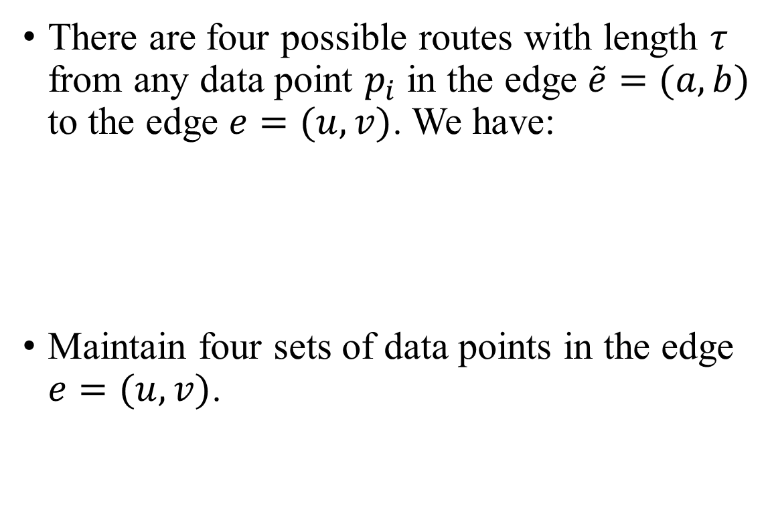









Neighbor-Sharing (NS) Method
There are four possible routes with length $τ$ from any data point $p_{i}$ in the edge $\tilde{e}=(a,b)$ to the edge $e=(u,v)$. We have:
Maintain four sets of data points in the edge $e=(u,v)$.
$$a$$
$$p_{i}$$
$$b$$
$$τ_{bu}(p_{i})$$
$$τ_{au}(p_{i})$$
$$τ_{bv}(p_{i})$$
$$τ_{av}(p_{i})$$
$$u$$
$$v$$
$$ℓ_{bu}(p_{i})$$
$$ℓ_{bv}(p_{i})$$
$$ℓ_{au}(p_{i})$$
$$ℓ_{av}(p_{i})$$

Slide 9






























Neighbor-Sharing (NS) Method
These four sets of data points exhibit the monotonicity property.
Takes $O(\left|P\left(\tilde{e}\right)\right|+\left|P(e)\right|)$) time to compute $C_{P}^{\left(\tilde{e},e\right)}\left(τ\right)$ ☺
Takes $O\left(LD\left(\left|E\right|T_{SP}+n\left|E\right|\right)+Ln\log{n}\right)$ time to generate the network K-function plot (Refer to the paper) ☺
$$a$$
$$p_{i}$$
$$p_{i+1}$$
$$a$$
$$p_{i}$$
$$p_{i+1}$$
$$b$$
$$b$$
$$ℓ_{bu}(p_{i+1})$$
$$ℓ_{bv}(p_{i+1})$$
$$ℓ_{au}(p_{i})$$
$$ℓ_{av}(p_{i})$$
$$ℓ_{bu}(p_{i})$$
$$ℓ_{bv}(p_{i})$$
$$ℓ_{au}(p_{i+1})$$
$$τ_{bu}(p_{i+1})$$
$$ℓ_{av}(p_{i+1})$$
$$u$$
$$u$$
$$v$$
$$v$$
$$τ_{bu}(p_{i})$$
$$τ_{bv}(p_{i+1})$$
$$τ_{bv}(p_{i})$$
$$τ_{au}(p_{i+1})$$
$$τ_{au}(p_{i})$$
$$τ_{av}(p_{i})$$
$$τ_{av}(p_{i+1})$$

Slide 10
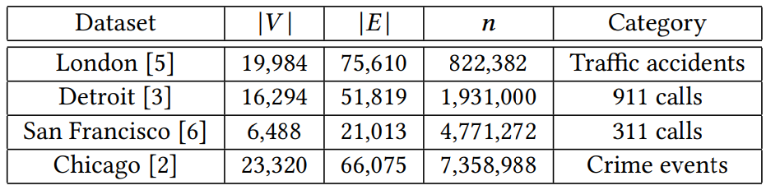
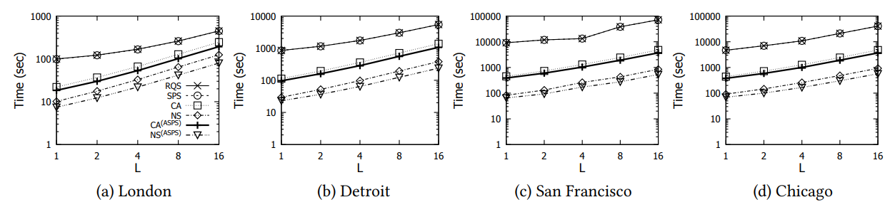
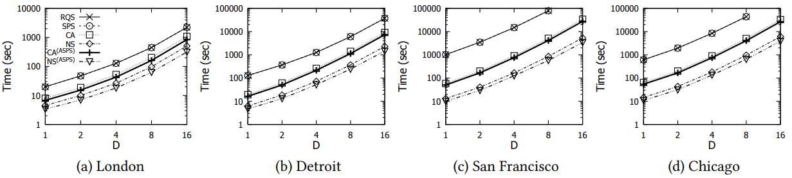


Experimental Evaluation
($D$ is fixed to be 5.)
($L$ is fixed to be 5.)

Slide 11
Ongoing Work and Future Opportunities
Develop efficient algorithms to further improve the efficiency for generating the network K-function plot?
Support spatiotemporal network K-function.
Develop the new software package, called LIBNET, which is based on our efficient algorithms, for supporting different operations of point pattern analysis in road networks.
Network kernel density visualization (NKDV)
Network K-function
Spatiotemporal network kernel density visualization (STNKDV)
Spatiotemporal network K-function
(Long-term goal) Develop a software package (like ArcGIS and Scikit-learn) that includes our complexity-reduced algorithms for different operations.

